Slide 1


DDSANALYTICS X FRITO LAY TALENT MANAGMENT
Project Kickoff - Detecting Employee Attrition
Let's get started

Slide 2


Am I getting paid enough?
Do I like my role?
How do my peers and coworkers treat me?
Am I spending too much time traveling?
Do I have a good work-life balance?
Do I like the leadership?

Slide 3
Background Research
Comprehensive Review of Reasons for Employee Attrition
Role Type and Role Autonomy
Business Travel
Work-Life Balance and Mental Health
Compensation and Benefits
Peer Relationships and Support
Culture
Tenure
Time to Complete Work
Corporate Social Responsibility
Daily Commute
Time Between Promotions
Leadership
Whitton, Robert Joshua. EXPLORING FACTORS FOR EMPLOYEE ATTRITION AND RETENTION BY LIFE STAGE , July 2023, https://doi.org/https://acrobat.adobe.com/id/urn:aaid:sc:AP:85aa1998-bfb7-4378-accc-0be3422976c4.

Slide 4

Our Dataset on Attrition
Summary of the Data:
870 Independent Observations
37 Variables/Factors (Numeric & Categorical)
No N/A Values or Missing Variables
Our Target Variable is “Attrition” (Yes/No)
Attrition | Count | Proportion
Yes | 140 | 16%
No | 730 | 84%

Slide 5

Numeric Varibales
ID | Hourly Rate | Distance From Home | Num of Companies Worked For | Total Working Years | Years in Current Role
Age | Monthly Rate | Employee Count (Constant 1) | Percent Salary Hike | Training Time Last Year | Years Since Last Promotion
Daily Rate | Monthly Income | Employee Number | Standard Hours (Constant 80) | Years at Company | Years with Current Manager

Slide 6
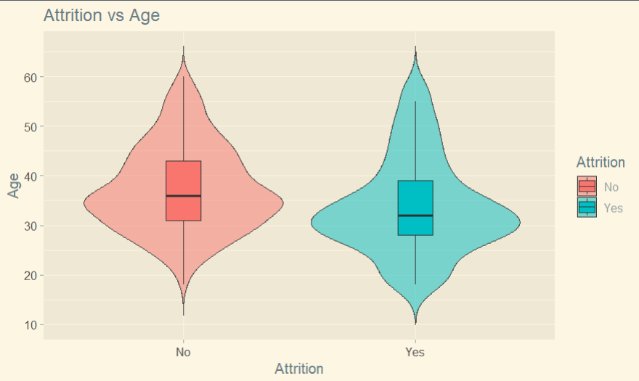
Wilcoxon Rank Sum Test for Significance
P-Value < 0.0001

Slide 7

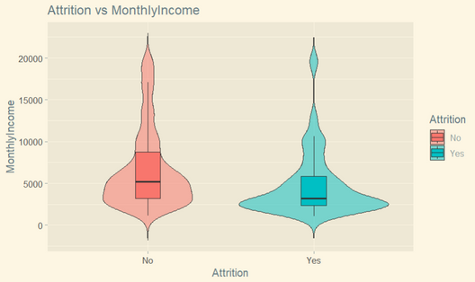
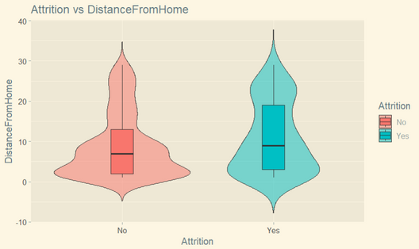
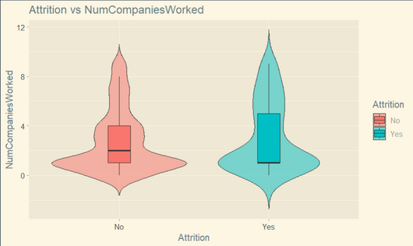
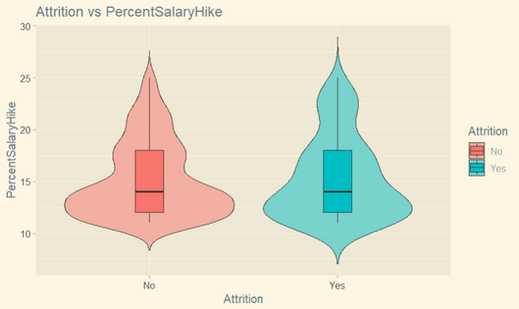
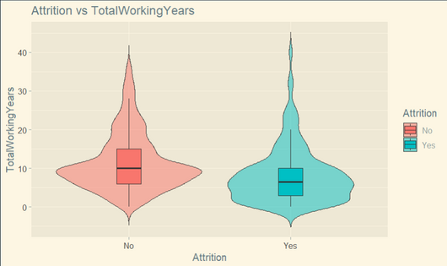
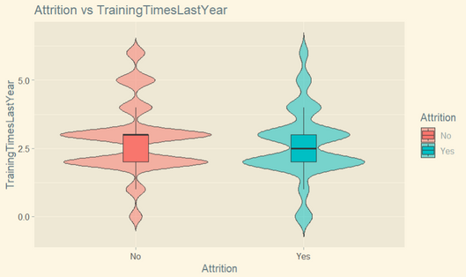
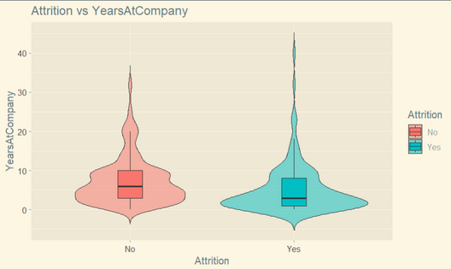
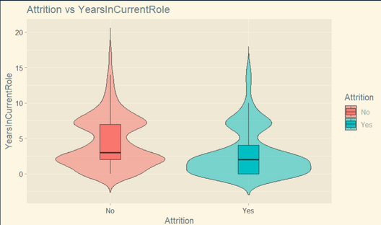
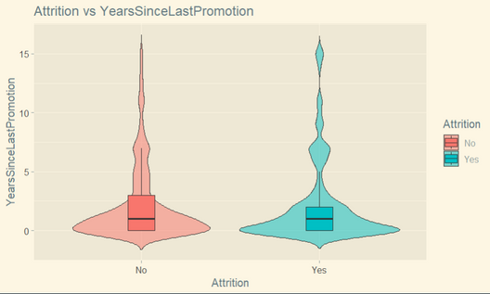
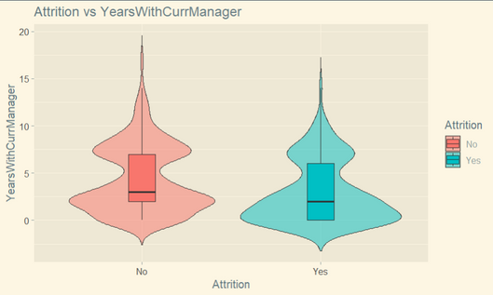
Numeric Variable Significance Alpha = 0.05
P-Value < 0.0001
P-Value < 0.0001
P-Value = 0.0273
P-Value = 0.1722
P-Value = 0.9759
P-Value < 0.0001
P-Value = 0.0922
P-Value < 0.0001
P-Value < 0.0001
P-Value = 0.3680
P-Value < 0.0001

Slide 8
Numeric Varibales
Numerical Variables
ID | Hourly Rate | Distance From Home | Num of Companies Worked For | Total Working Years | Years in Current Role
Age | Monthly Rate | Employee Count (Constant 1) | Percent Salary Hike | Training Time Last Year | Years Since Last Promotion
Daily Rate | Monthly Income | Employee Number | Standard Hours (Constant 80) | Years at Company | Years with Current Manager

Slide 9
Categorical Variables
Attrition | Education | Gender | Job Role | Over 18 (Constant Yes) | Relationship Satisfaction
Business Travel | Education Field | Job Involvement | Job Satisfaction | Over Time | Stock Option Level
Department | Environmental Satisfaction | Job Level | Marital Status | Performance Rating (Ranked Excellent and Outstanding) | Work-Life Balance

Slide 10
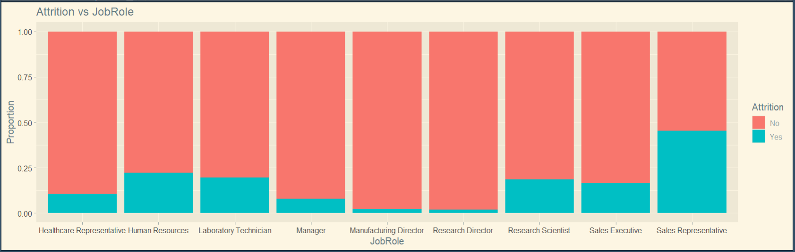
Chi-Square Test for Significance
P-Value < 0.0001

Slide 11
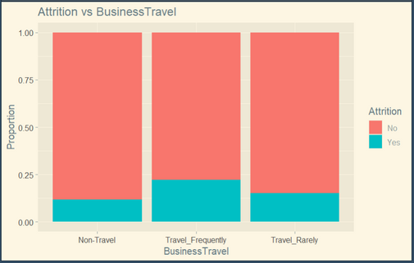
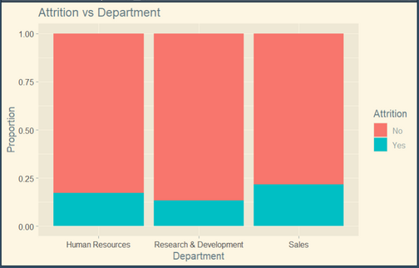
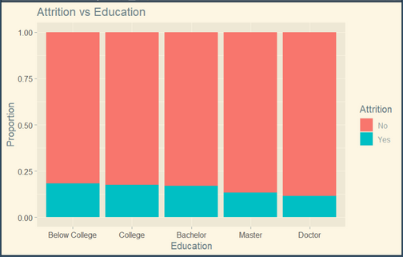
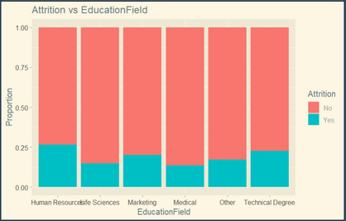
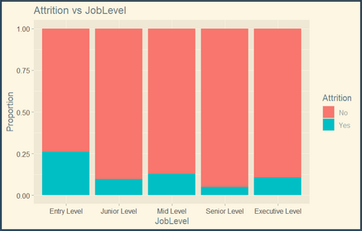
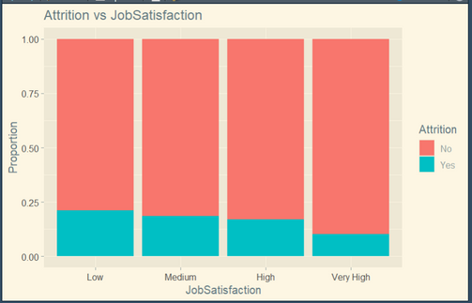
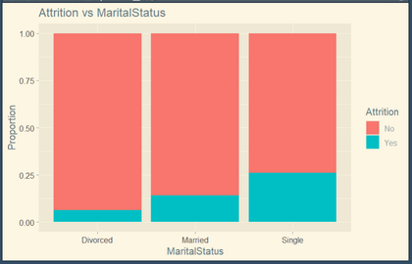
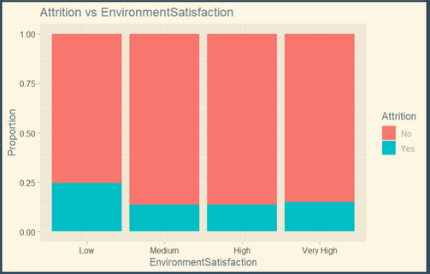
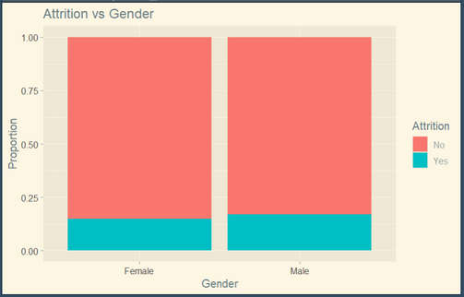
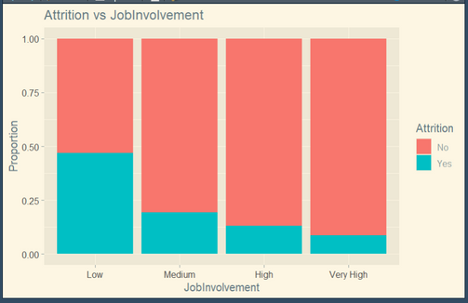
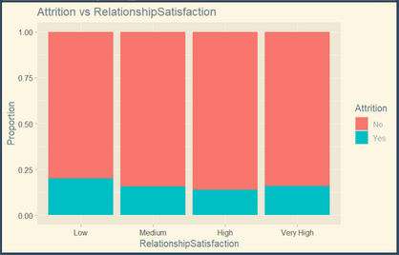
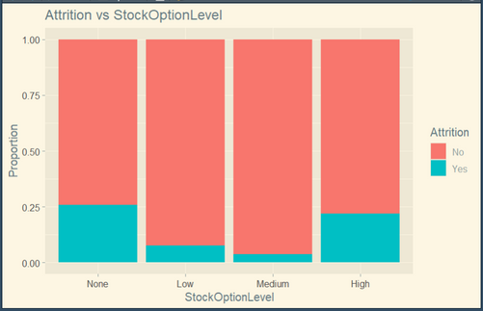
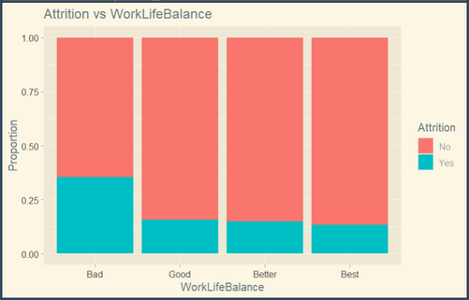
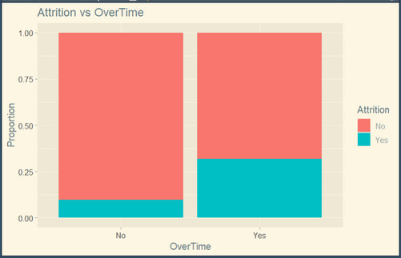
Categorical Variable Significance
P-Value = 0.0499
P-Value = 0.0094
P-Value = 0.6243
P-Value = 0.2682
P-Value < 0.0001
P-Value = 0.0111
P-Value < 0.0001
P-Value = 0.0105
P-Value = 0.5151
P-Value < 0.0001
P-Value = 0.3727
P-Value < 0.0001
P-Value = 0.0002
P-Value < 0.0001

Slide 12
Categorical Variables
Categorical Variables
Attrition | Education | Gender | Job Role | Over 18 (Constant Yes) | Relationship Satisfaction
Business Travel | Education Field | Job Involvement | Job Satisfaction | Over Time | Stock Option Level
Department | Environmental Satisfaction | Job Level | Marital Status | Performance Rating (Ranked Excellent and Outstanding) | Work-Life Balance

Slide 13
Fitting Significant Variables for Models
Features Used in our KNN and Naive Bayes Classifier Models
Numeric:
Age
Monthly Income
Distance From Home
Total Working Years
Years at Company
Years in Current Role
Years with Current Manager
Categorical
Attrition (Target Variable)
Business Travel
Department
Enviromental Satisfaction
Job Involvement
Job Level
Job Role
Job Satisfaction
Marital Status
OverTime
Stock Option Level
Work-Life Balance
Train and Test Split: 70/30
KNN Model:
K = 65 (Best K Value)
10-Fold Cross Validation
Threshold Adjustment = 0.50
Naive Bayes:
Attrition ~ All Selected Features
Threshold Adjustment = 0.75

Slide 14
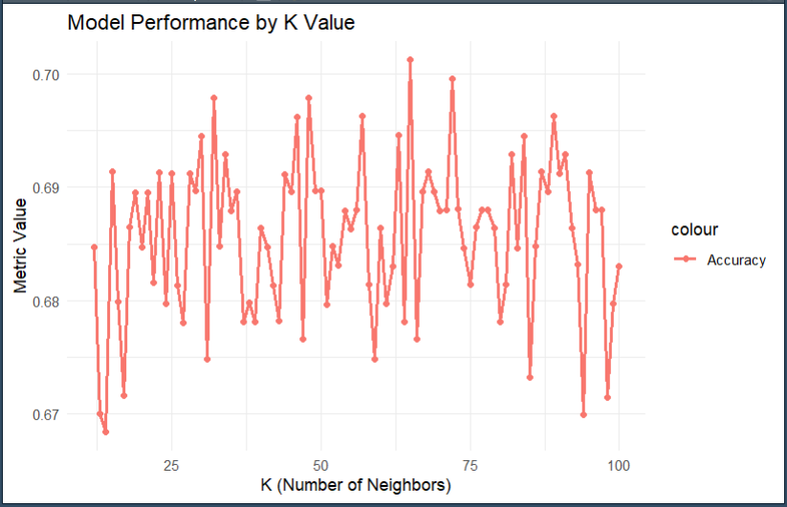
Finding Best K Value for KNN Model
K=65

Slide 15
Metrics Explained (Sensitivity and Specificity)
Metric | Translated to Talent Management | When it Matters Most
Sensitivity (TP Rate) | Don’t want to miss detecting employees that are leaving | If turnover is very costly
Specificity (TN Rate) | Don’t waste retention budget on happy employees | If retention programs cost lots of money

Slide 16
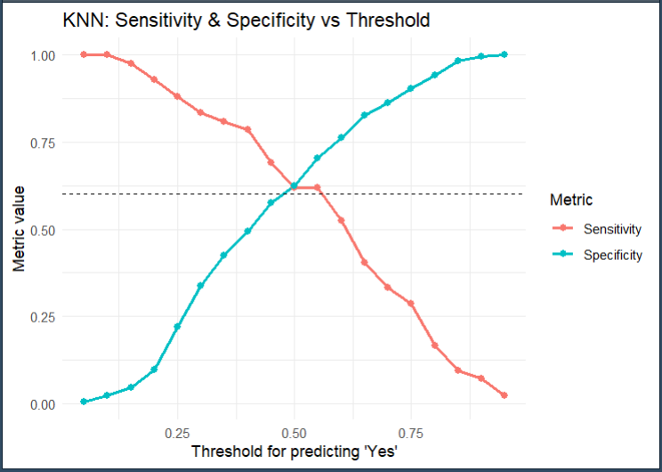
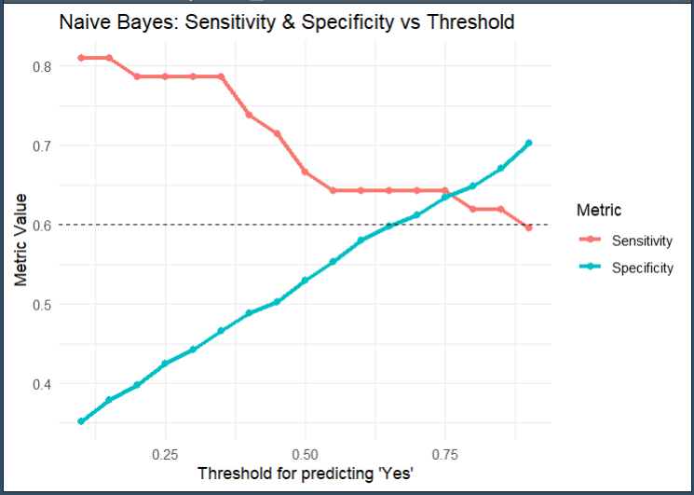
Finding Threshold for KNN & Naive Bayes

Slide 17
Model Results
Actual
Attrition | Yes | No
Yes | 26 | 82
No | 16 | 137
Accuracy: 62.45%
Sensitivity: 61.90%
Specificity: 62.55%
KNN Model
Predicted
Actual
Attrition | Yes | No
Yes | 27 | 80
No | 15 | 139
Accuracy: 63.60%
Sensitivity: 64.29%
Specificity: 63.47%
Naive Bayes Model
Predicted

Slide 18
Cost Analysis
Attrition | Yes | No
Yes | 26 | 82
No | 16 | 137
Assuming Average Salary is $65,000, it costs on average 225% of someone's salary to replace them if they left the company.
KNN Model
Actual
KNN Model
Fail to estimate 16 x (2.25 x $65,000) = $2.3 Mil in Replacement Costs
Naive Bayes Model
Fail to estimate 15 x (2.25 x $65,000) = $2.2 Mil in Replacement Costs
Attrition | Yes | No
Yes | 27 | 80
No | 15 | 139
Predicted
Frito Lay’s Incentive Program has estimated the cost of incentives to be around $200 per employee.
Naive Bayes Model
Actual
KNN Model
Spending an extra 82 x $200 = $16,400 on Retention Programs
Predicted
Naive Bayes Model
Spending an extra 80 x $200 = $16,000 on Retention Programs

Slide 19

Future Insight and Reccomendations
Find out what matters most retention program costs or replacement costs of employees
Tune Adjustment based on what is more important
Explore other Machine Learning Methods (e.g. Deep Learning and Neural Networks to Detect Attrition to minimize costs on both sides

Slide 20
Questions!

